Slide 1
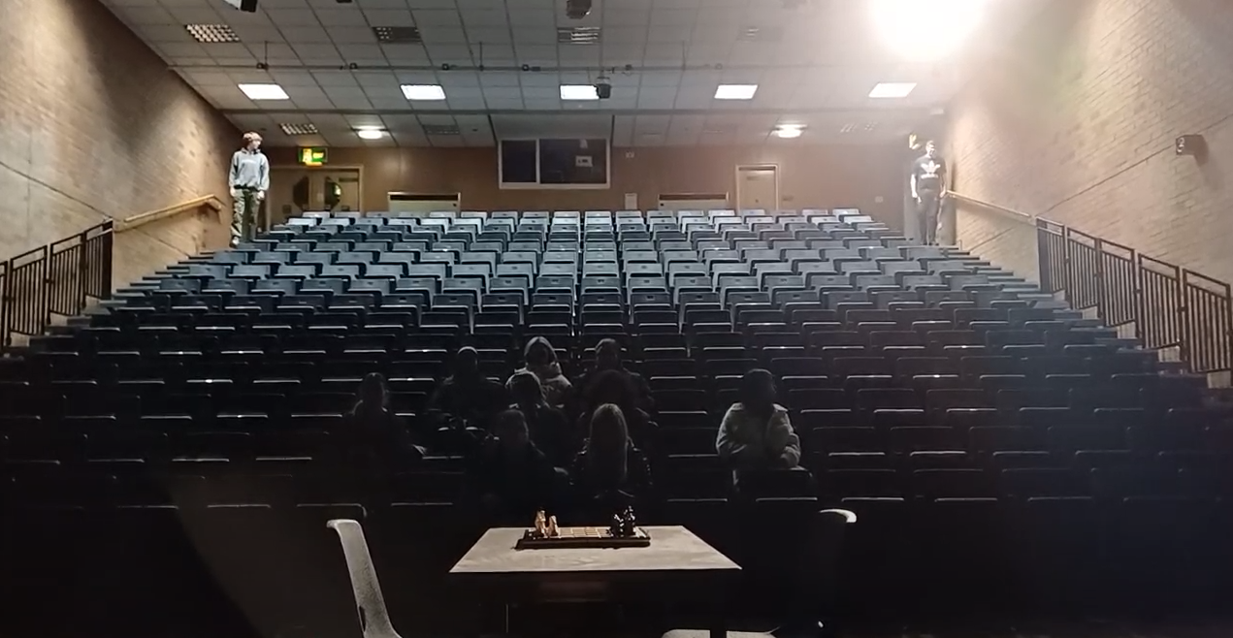
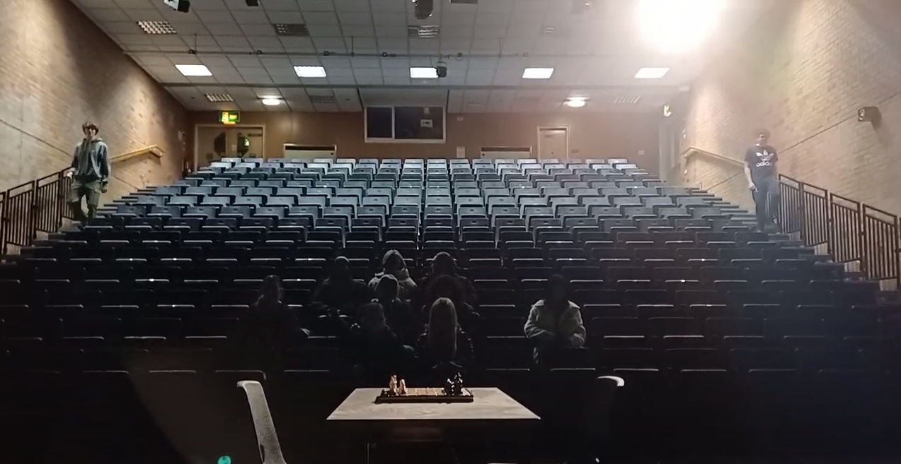
Name: William
Candidate No:
Production Title:
Death Match
Sheet X of 15
Scene Heading | INT: Chess Match Hall - Mid Day:
Shot No. | 1, 1B, 1C
Shot Type/ camera movement | Wide Shot
Lighting | Key Lighting
Action/scene description/ dialogue from the screenplay | The room is dark. A large crowd is facing a table with a complete, traditional chess board in the middle of the stage. Spotlights turn on from the back of the Hall to the front.
Diegetic Sound | Sound of the competitors walking down the stairs and maybe some audience whispers
Non Diegetic sound | Tense but faint music. Maybe some violins playing a high note. Progressively gets louder
Duration of shot | 10 seconds | Transition type | cut

Slide 2
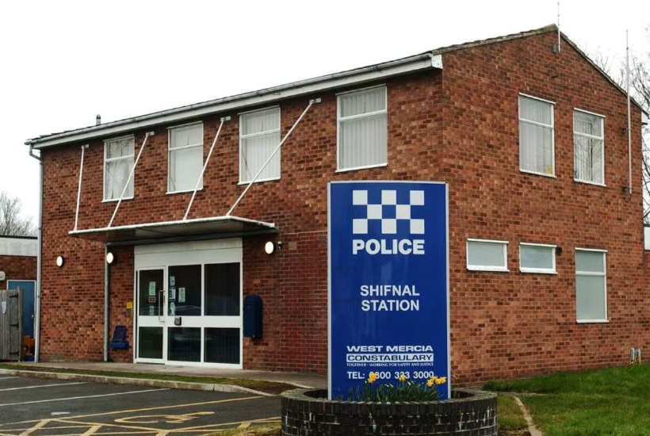
Name:
Candidate No:
Production Title:
Sheet X of 10
Scene Heading | Police station EXT - mid day
Shot No. | 2
Shot Type/ camera movement | Still camera movement
Lighting | Natural
Action/scene description/ dialogue from the screenplay | No dialogue
Diegetic Sound | Possible cars driving post the police station
Non Diegetic sound | Once the previous scene is done, music is cut off instantly.
Duration of shot | 3 seconds | Transition type | cut

Slide 3
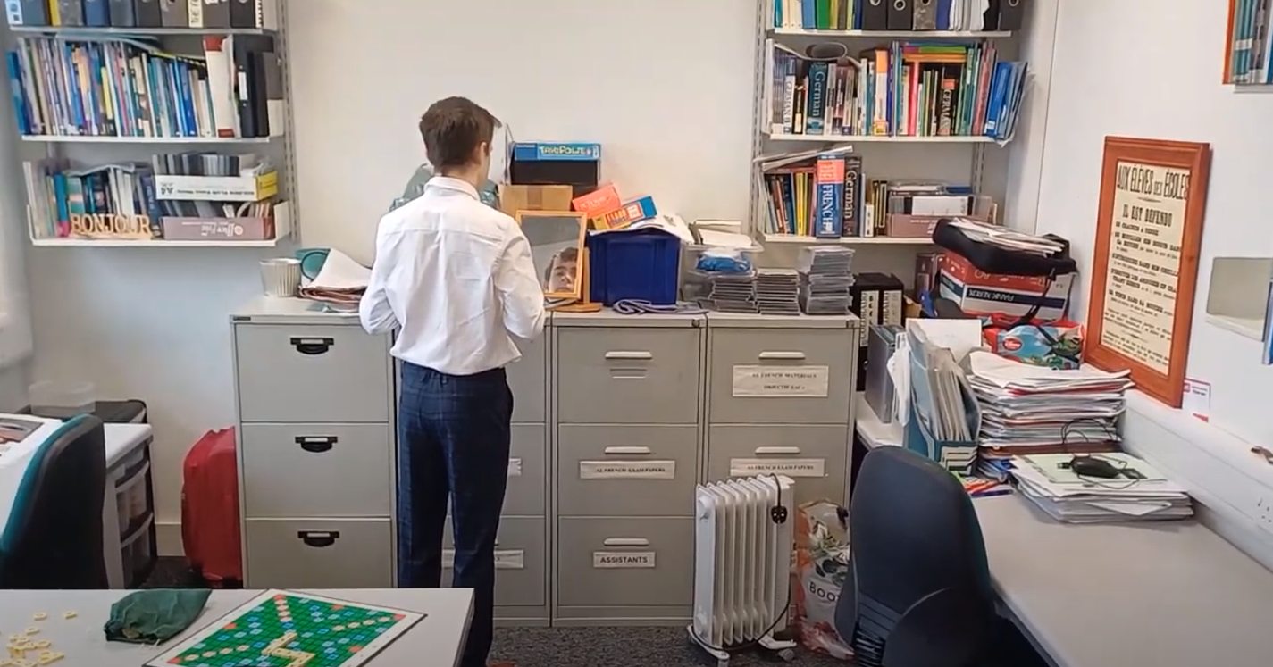
Name:
Candidate No:
Production Title:
Sheet X of 10
Scene Heading | Police station Int - Mid day
Shot No. 3 | 3
Shot Type/ camera movement | Dolly into shot 4
Lighting | Natural lighting coming from window
Action/scene description/ dialogue from the screenplay | No dialogue
Diegetic Sound | Ambient sounds of the location (maybe some music playing in background - could use songs that have famously been used in previous detective films to add references)
Non Diegetic sound | Not needed
Duration of shot | 5 seconds | Transition type | cut

Slide 4
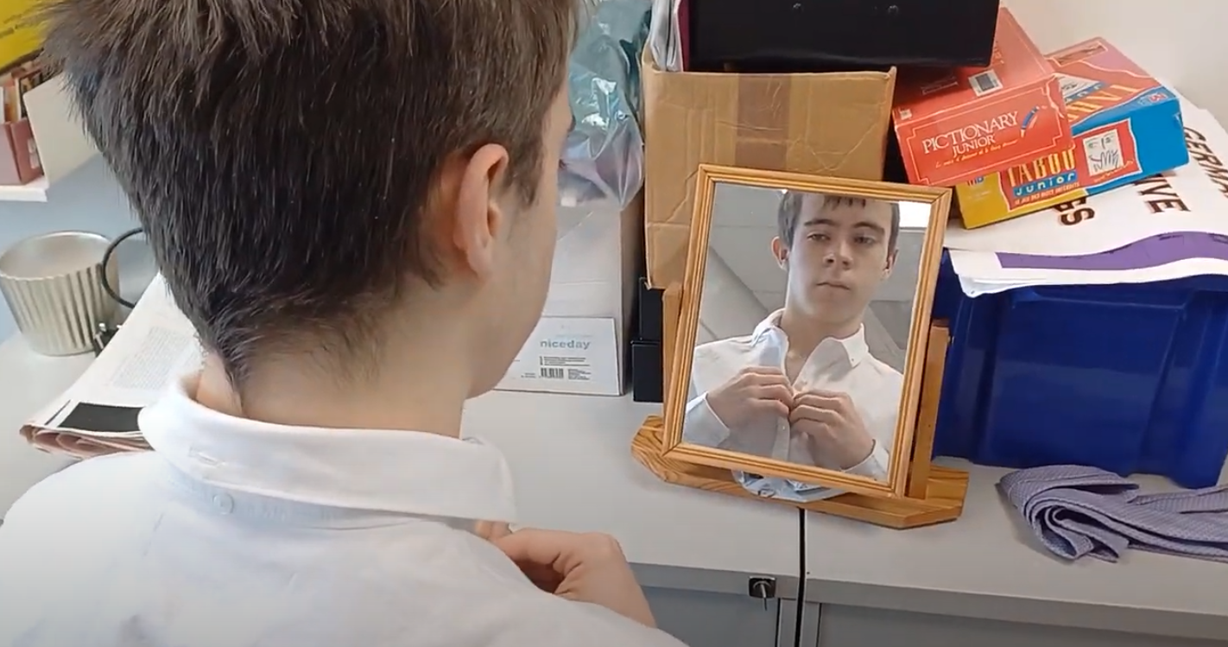
Name:
Candidate No:
Production Title:
Sheet X of 10
Scene Heading | Police station INT - Mid day
Shot No. | 4
Shot Type/ camera movement | Stationary.
Lighting | Natural
Action/scene description/ dialogue from the screenplay | The DI is buttoning up his shirt in the mirror
Diegetic Sound | Ambient sounds of the location (maybe some music playing in background)
Non Diegetic sound | No sound
Duration of shot | 6 seconds | Transition Type | Cut

Slide 5
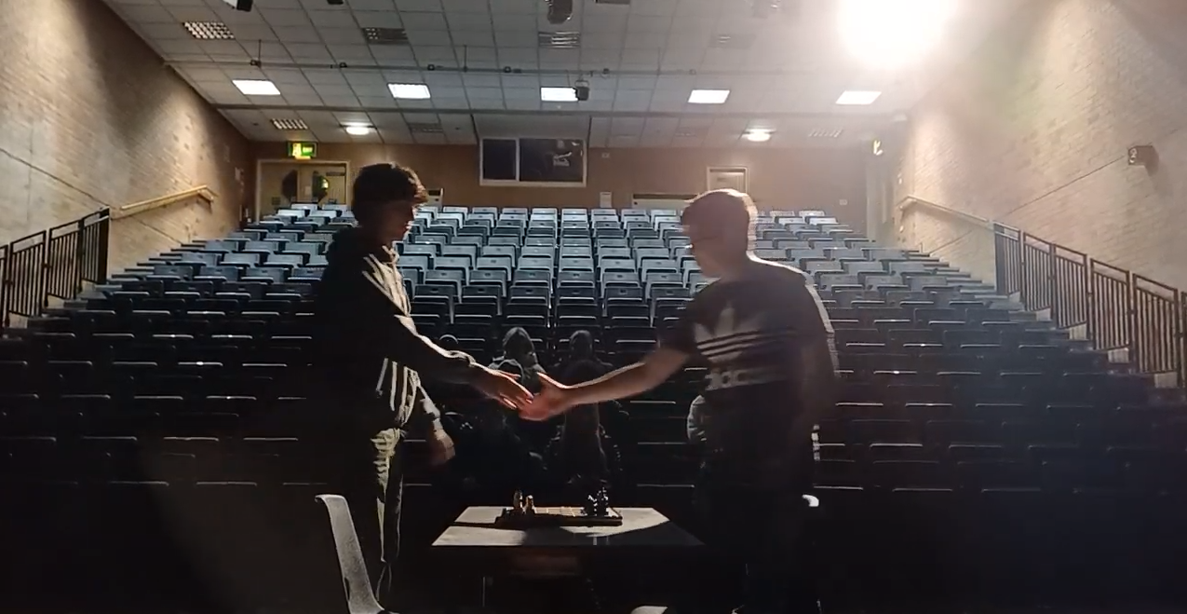
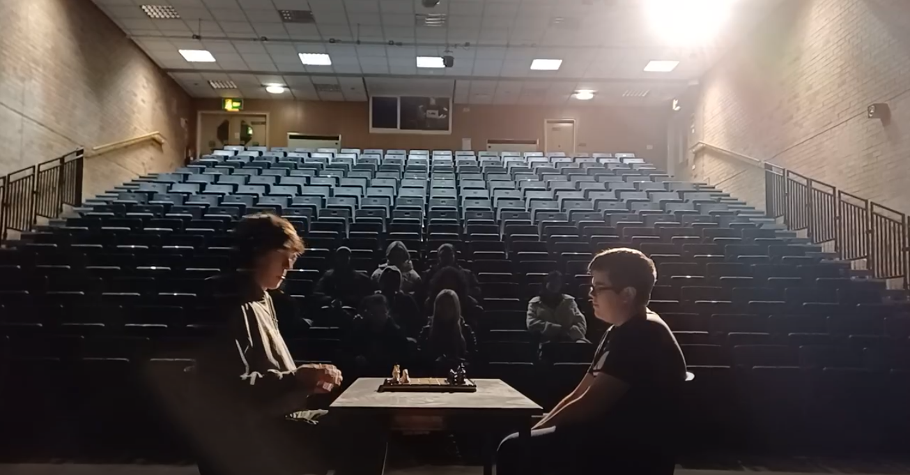
Name:
Candidate No:
Production Title:
Sheet X of 10
Scene Heading | Chess Match Hall INT - Mid day
Shot No. | 5, 5B
Shot Type/ camera movement | Ped
Lighting | Key Lighting
Action/scene description/ dialogue from the screenplay | Our competitors sit down and face each other.
Diegetic Sound | going away from long notes with violins we could have quiet sudden notes building tension.
Non Diegetic sound
Duration of shot | 4 seconds | Transition Type | cut

Slide 6
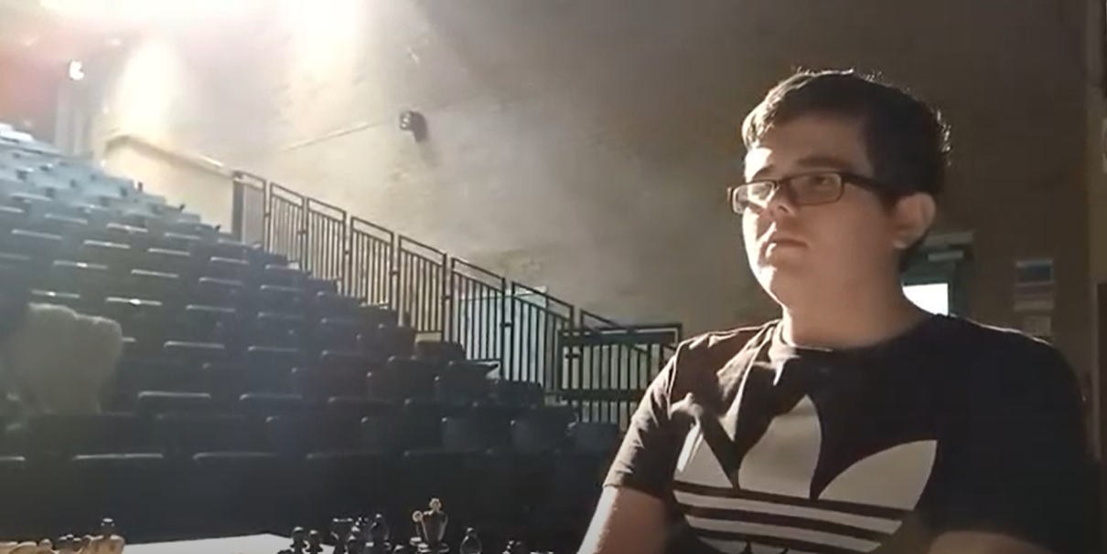
Name:
Candidate No:
Production Title:
Sheet X of 10
Scene Heading | Chess Match Hall INT - Mid Day
Shot No. | 6
Shot Type/ camera movement | Reverse angle (I think)
Lighting
Action/scene description/ dialogue from the screenplay | Our killer (Which we don’t know that at this point looks at the victim (which we also don’t know at this point).
Diegetic Sound | Crowd whispering
Non Diegetic sound | Music cuts to silence
Duration of shot | 2 seconds | Transition Type | cut

Slide 7
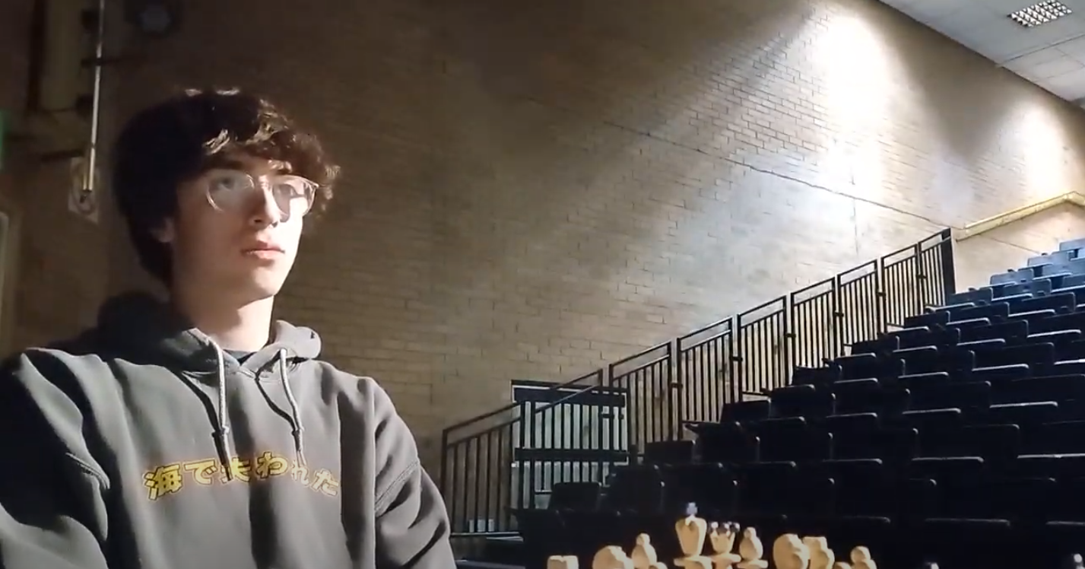
Name:
Candidate No:
Production Title:
Sheet X of 10
Scene Heading | Chess Match Hall INT - Mid Day
Shot No. | 7
Shot Type/ camera movement | Reverse angle (I think)
Lighting
Action/scene description/ dialogue from the screenplay | Our victim (Which we don’t know that at this point looks at the killer (which we also don’t know at this point).
Diegetic Sound | Ambient sounds of the location
Non Diegetic sound | music still silent
Duration of shot | 2 seconds | Transition Type | cut

Slide 8
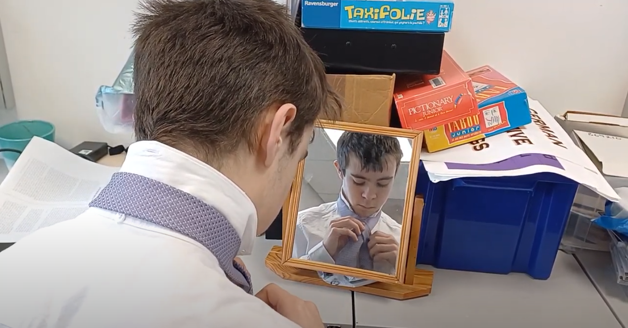
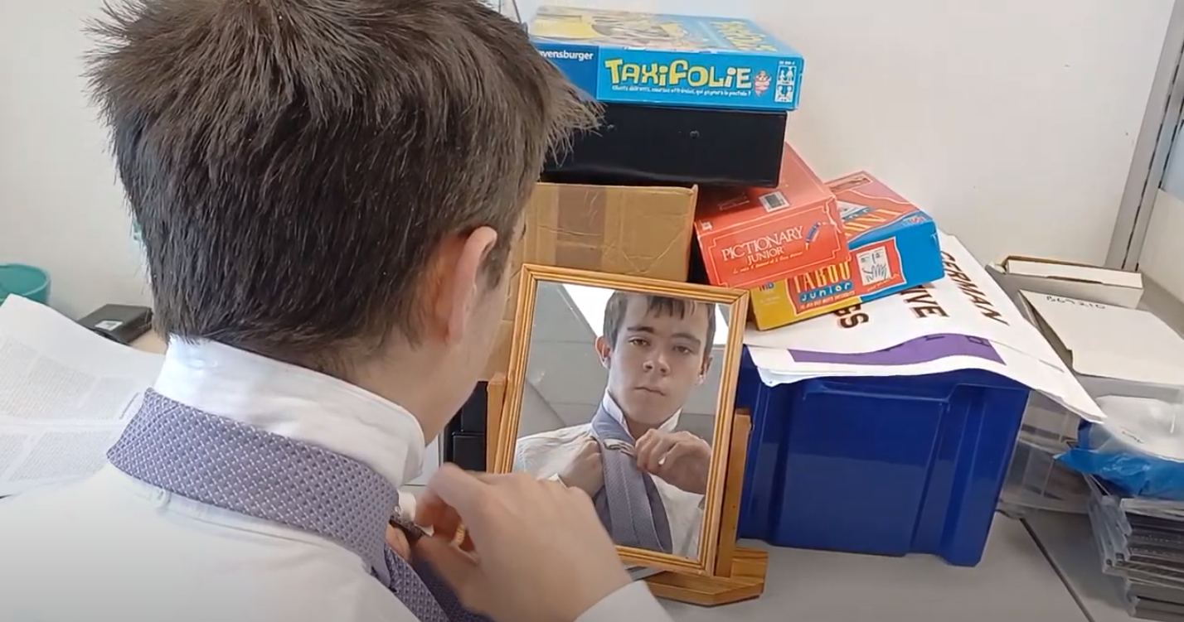
Name:
Candidate No:
Production Title:
Sheet X of 10
Scene Heading | Police station INT - Mid Day
Shot No. | 8, 8B
Shot Type/ camera movement | Stationary
Lighting | Natural light coming from window
Action/scene description/ dialogue from the screenplay | Charlie Hulme (The DI) is tying his tie
Diegetic Sound | Ambient sounds of the area
Non Diegetic sound | Music still playing
Duration of shot | 5 seconds | Transition Type | dissolve

Slide 9
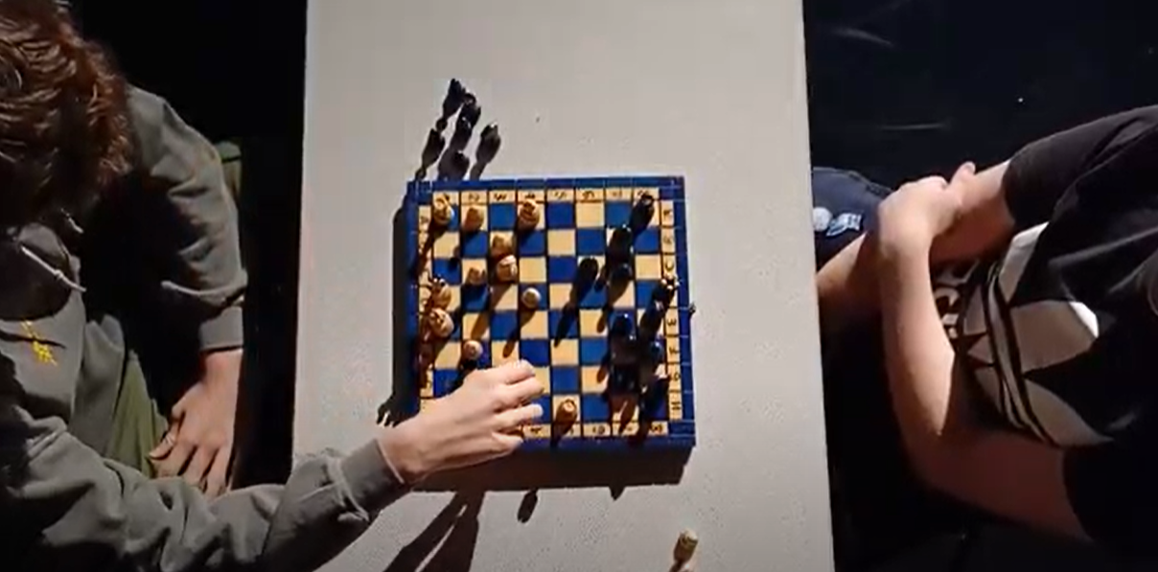
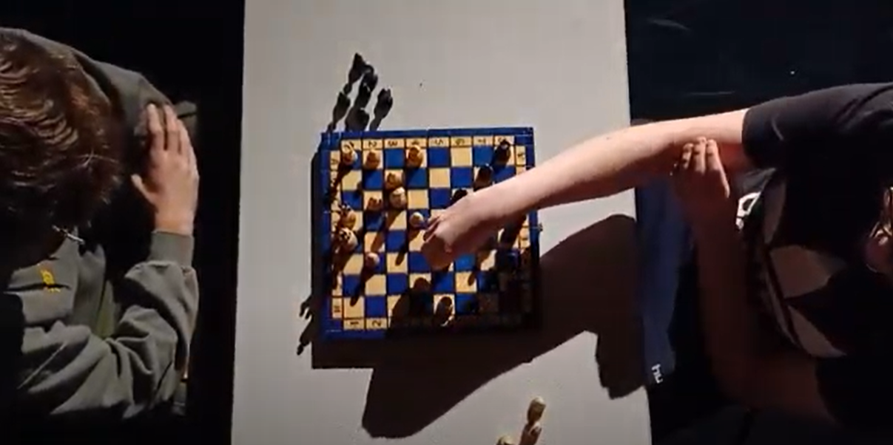
Name:
Candidate No:
Production Title:
Sheet X of 10
Scene Heading | Chess match Hall INT - Mid Day.
Shot No. | 9, 9B
Shot Type/ camera movement | God shot
Lighting | Key Lighting
Action/scene description/ dialogue from the screenplay | The Champion Chess Players move their first pieces
Diegetic Sound | (The Chess clicker?)and chess pieces moving
Non Diegetic sound | non
Duration of shot | 5 | Transition Type | cut

Slide 10
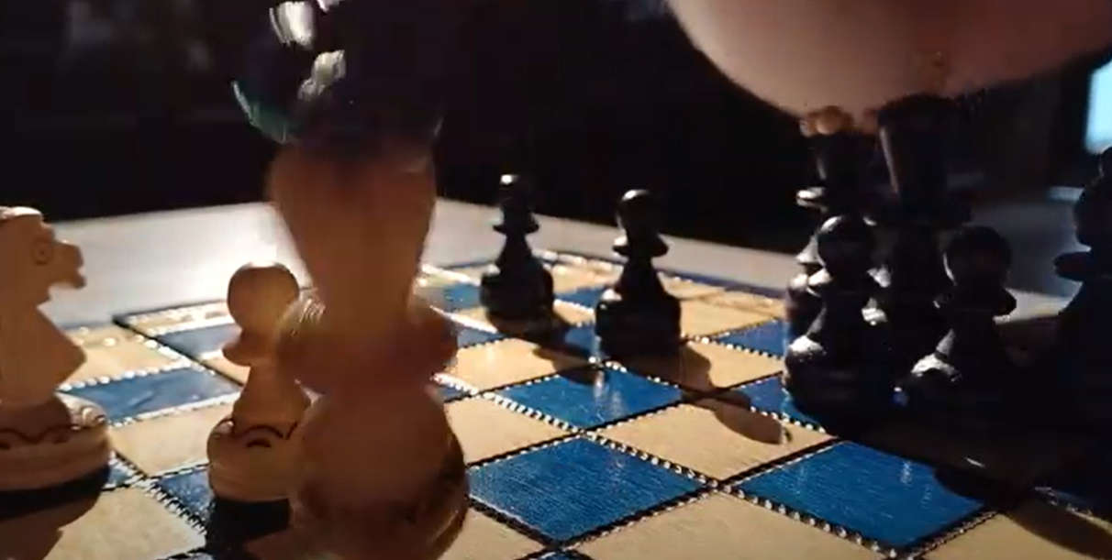
Name:
Candidate No:
Production Title:
Sheet X of 10
Scene Heading | Chess Match Interior
Shot No. | 10
Shot Type/ camera movement | Close up
Lighting | Back Light
Action/scene description/ dialogue from the screenplay | The victim loses a very important piece (Also Adda bit of slow motion.
Diegetic Sound | Ambient sounds of the location
Non Diegetic sound | echoed (enhanced sound) of chess piece falling down.
Duration of shot | 4 (Slow motion) | Transition Type | cut to black

Slide 11
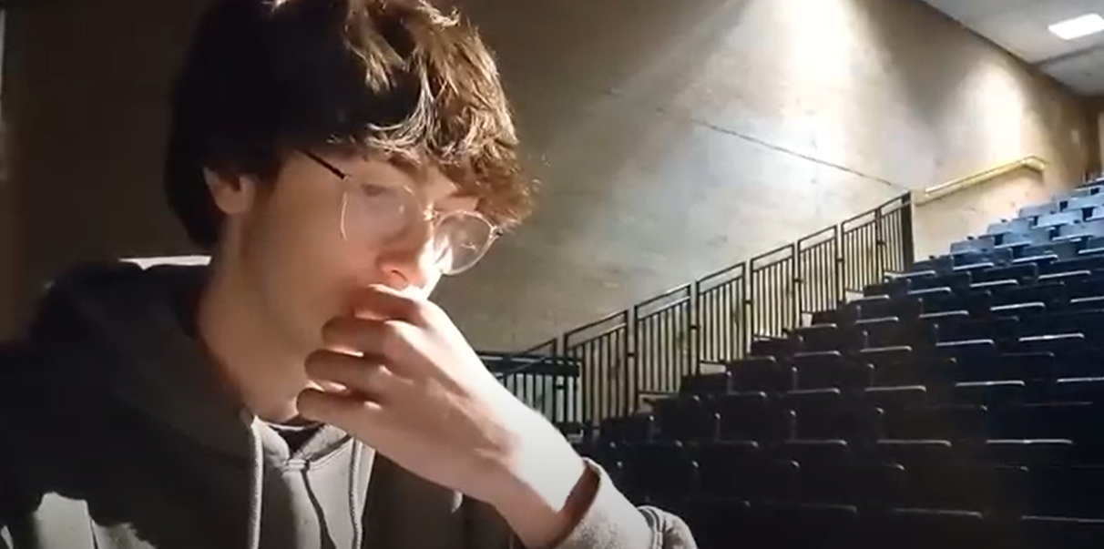
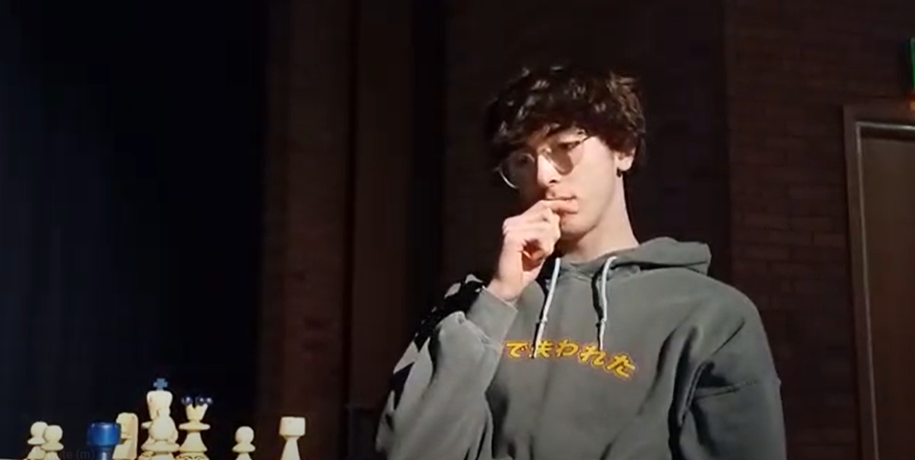
Name:
Candidate No:
Production Title:
Sheet X of 10
Scene Heading | Chess Match Hall INT - Mid Day
Shot No. | 11, 11B
Shot Type/ camera movement | Crossing the Axis
Lighting | Backlighting + Hard lighting
Action/scene description/ dialogue from the screenplay | The Victim puts his hands to his lips causing him to ingest the poison
Diegetic Sound | audience in a little bit of shock due to a well known player losing such an important pieces
Non Diegetic sound | Brass instruments to signify something is going to happen.
Duration of shot | 5 seconds | Transition Type | fade in from black

Slide 12
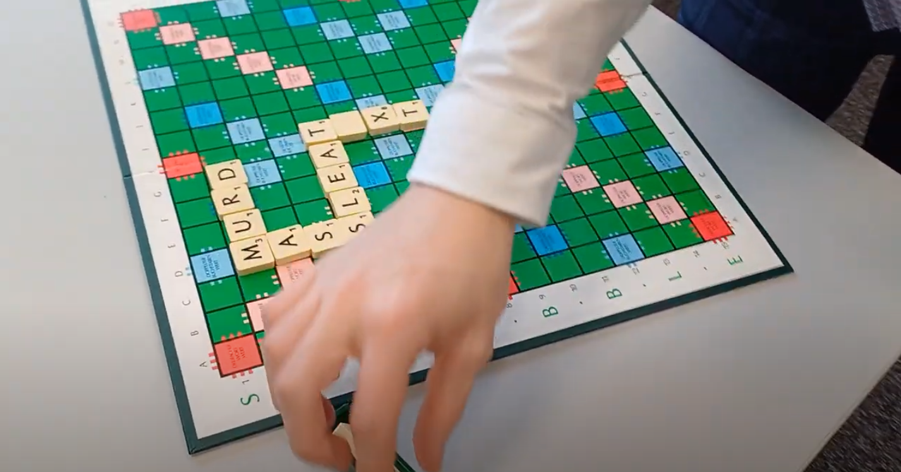
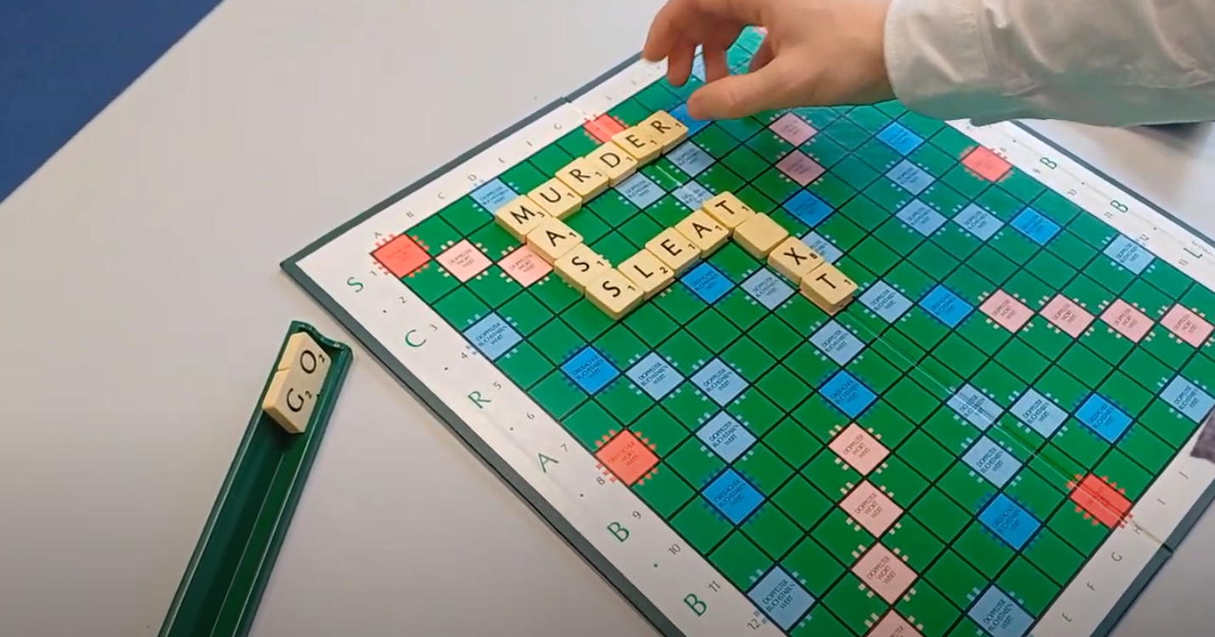
Name:
Candidate No:
Production Title:
Sheet X of 10
Scene Heading | Police Station INT - MID Day
Shot No. | 12, 12B
Shot Type/ camera movement | (Will Have to ask Nick what this shot would be as it is in a rotary style around the scrabble board.
Lighting | Natural Lighting
Action/scene description/ dialogue from the screenplay | The DI plays scrabble by himself making the word murder as one of the words he put on the board.
Diegetic Sound | Ambient sounds of the location (Music is still being played)
Non Diegetic sound | non
Duration of shot | 8 seconds | Transition Type | cut

Slide 13
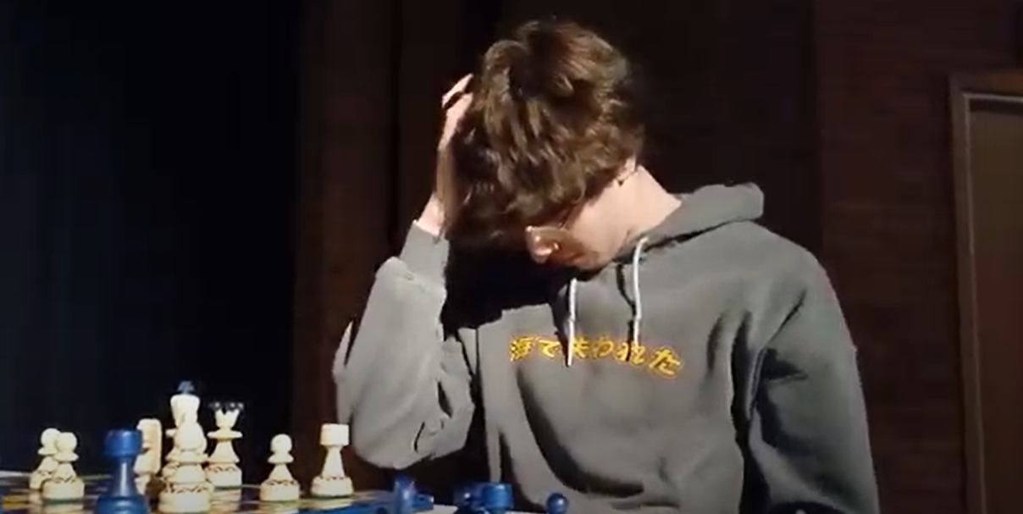
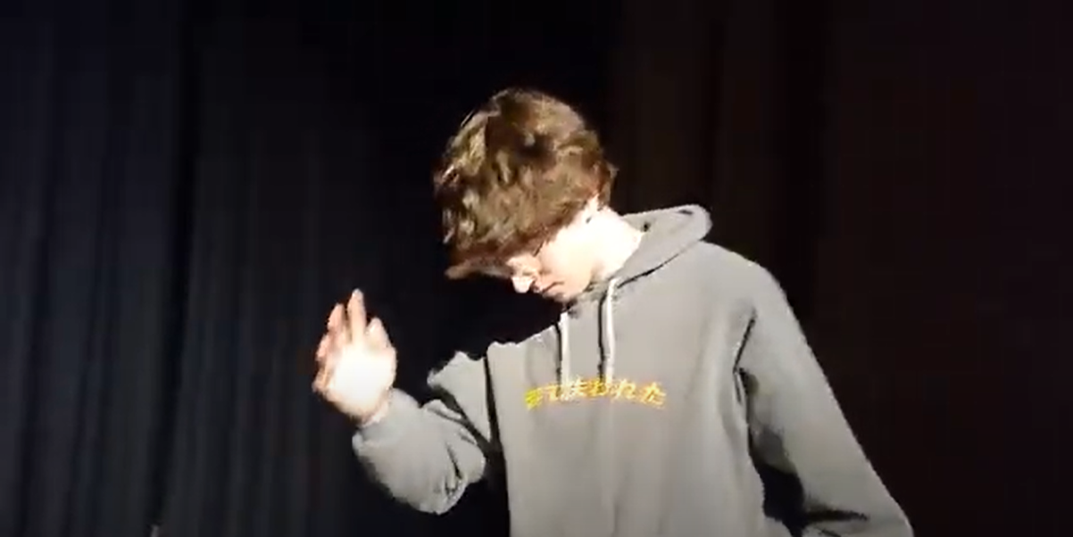
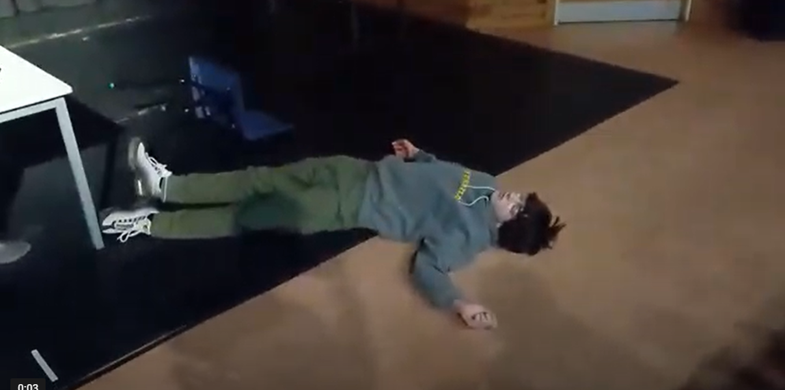
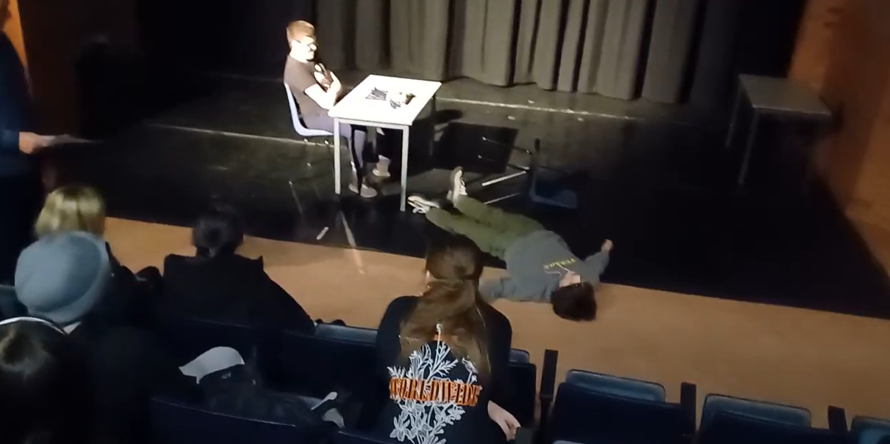
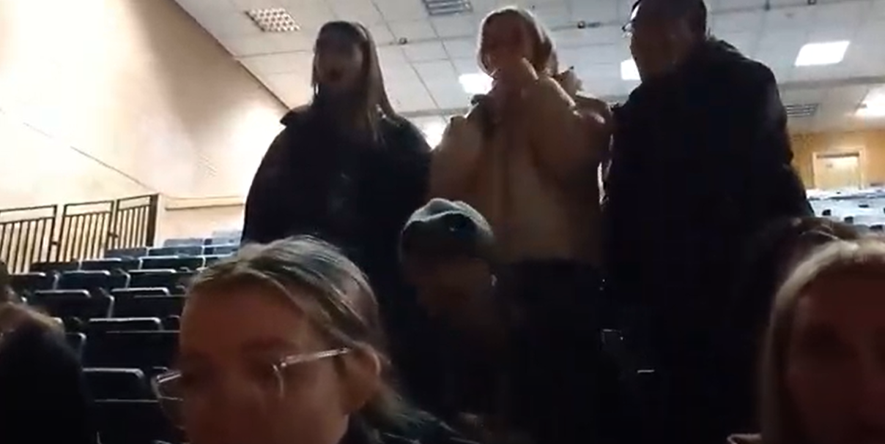
Name:
Production Title:
Candidate No:
Sheet X of 10
Scene Heading | Chess Match Hall INT - Mid Day
Shot No. | 13, 13B, 13C, 13D, 13 E
Shot Type/ camera movement | ( Will Have to get Nicks Advice on what shots this would include but I will put it down as jump cut
Lighting | Harsh Lighting
Action/scene description/ dialogue from the screenplay | Our Victim dies due to unknown circumstances at this point
Diegetic Sound | Ambient sounds of the location
Duration of shot | 10 seconds | Transition | cut

Slide 14
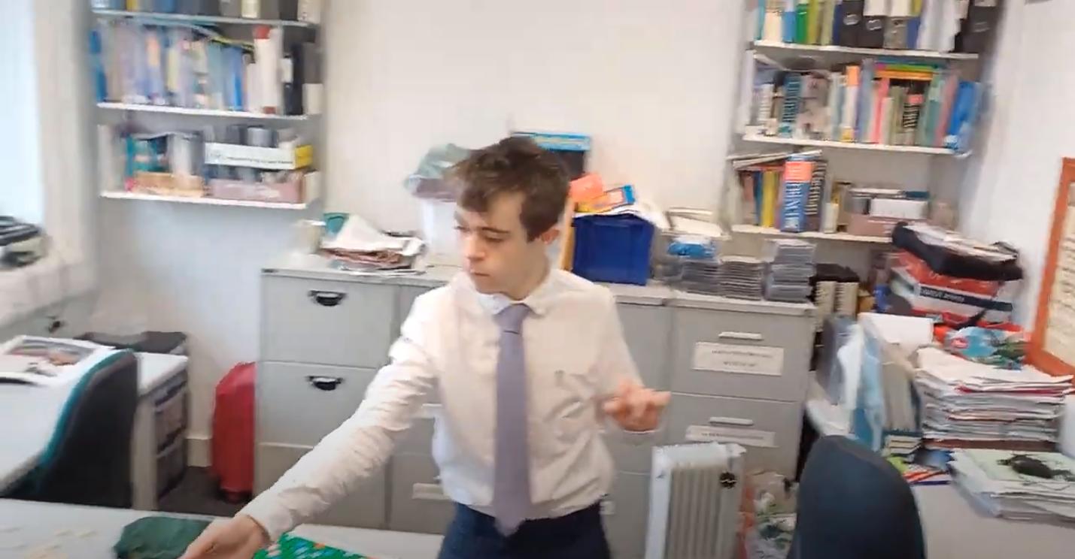
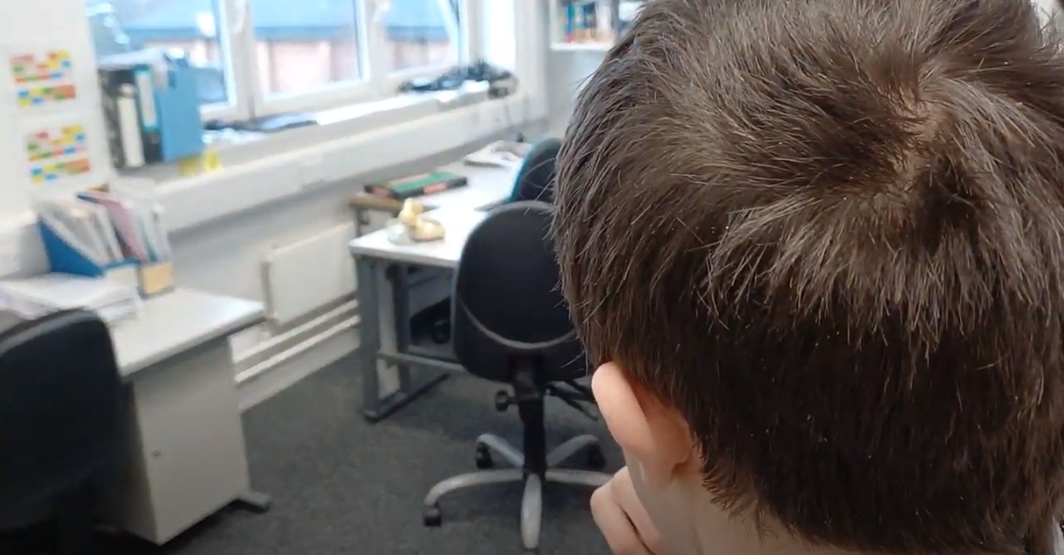
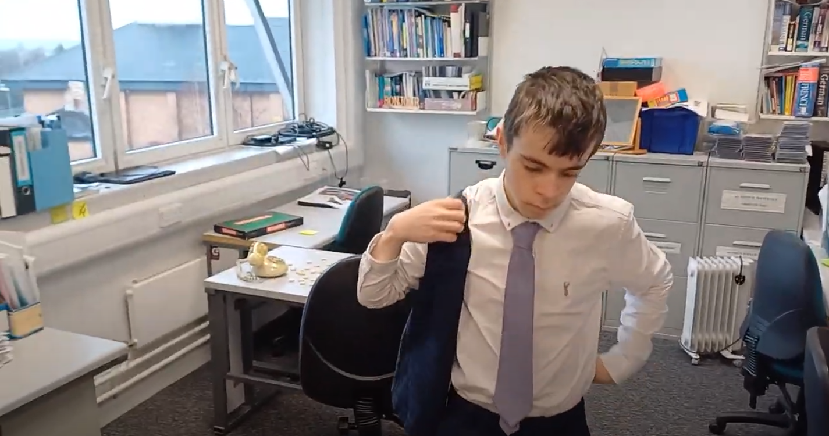
Name:
Candidate No:
Production Title:
Sheet X of 10
Scene Heading | Police Station INT - Mid Day
Shot No. | 14, 14B, 14C
Shot Type/ camera movement | wide shot to close up (no camera movement)
Lighting | Natural lighting
Action/scene description/ dialogue from the screenplay | The DI puts on his waistcoat and is about to head out the door
Diegetic Sound | Ambient sounds of the location
Non Diegetic sound | The violins come back as non Diegetic sound, linking the detective and the murder that just occured
Duration of shot | 7 seconds | Transition Type | Cut in and shot reverse shot after to shot 15

Slide 15
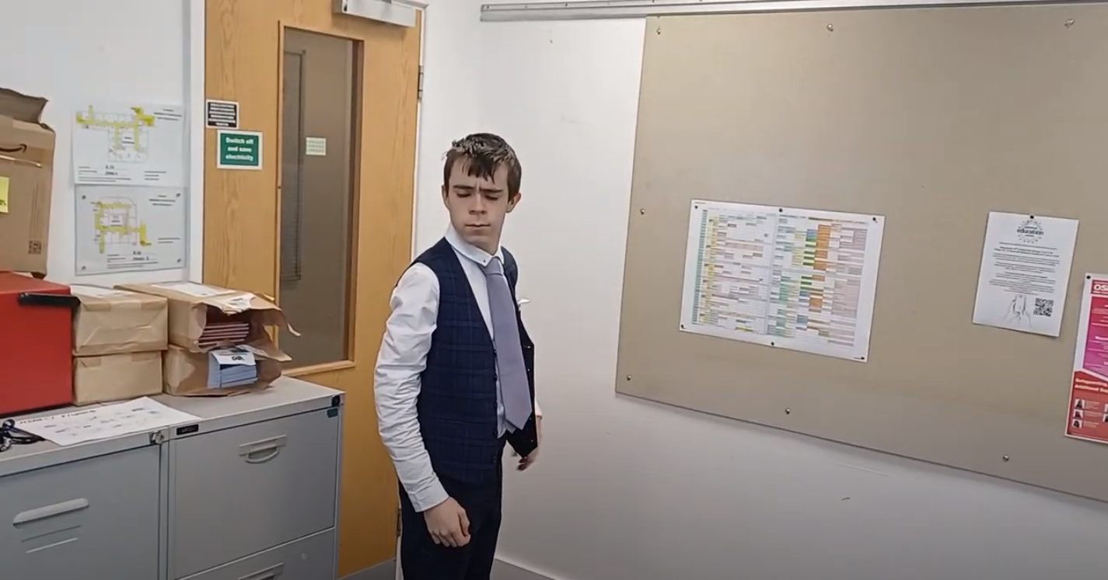
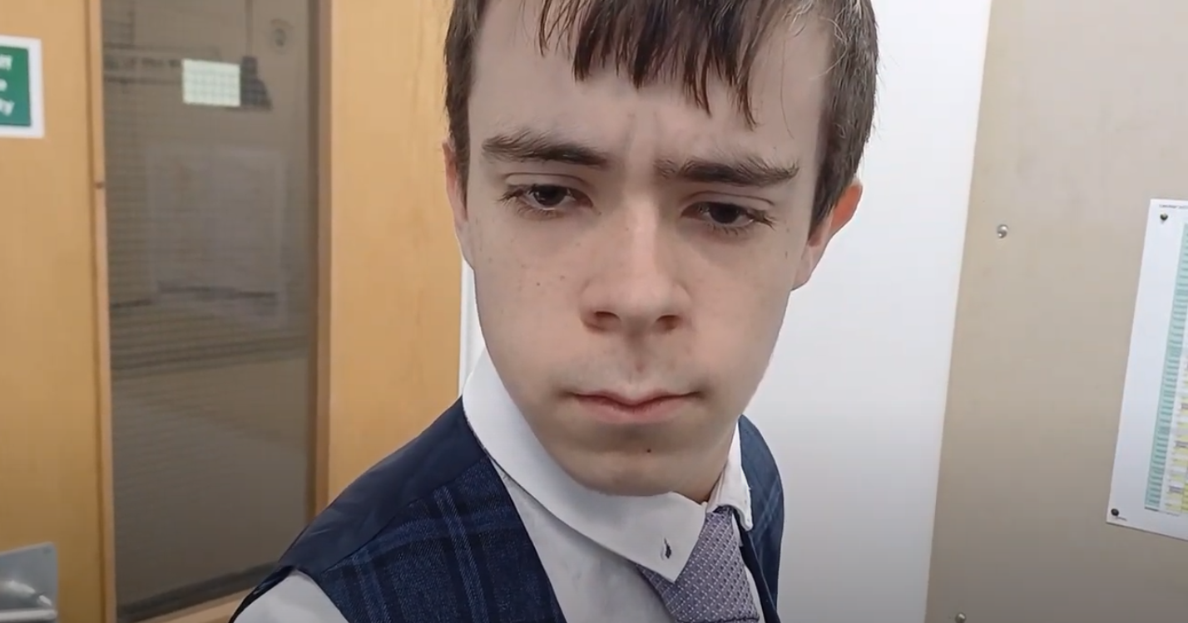
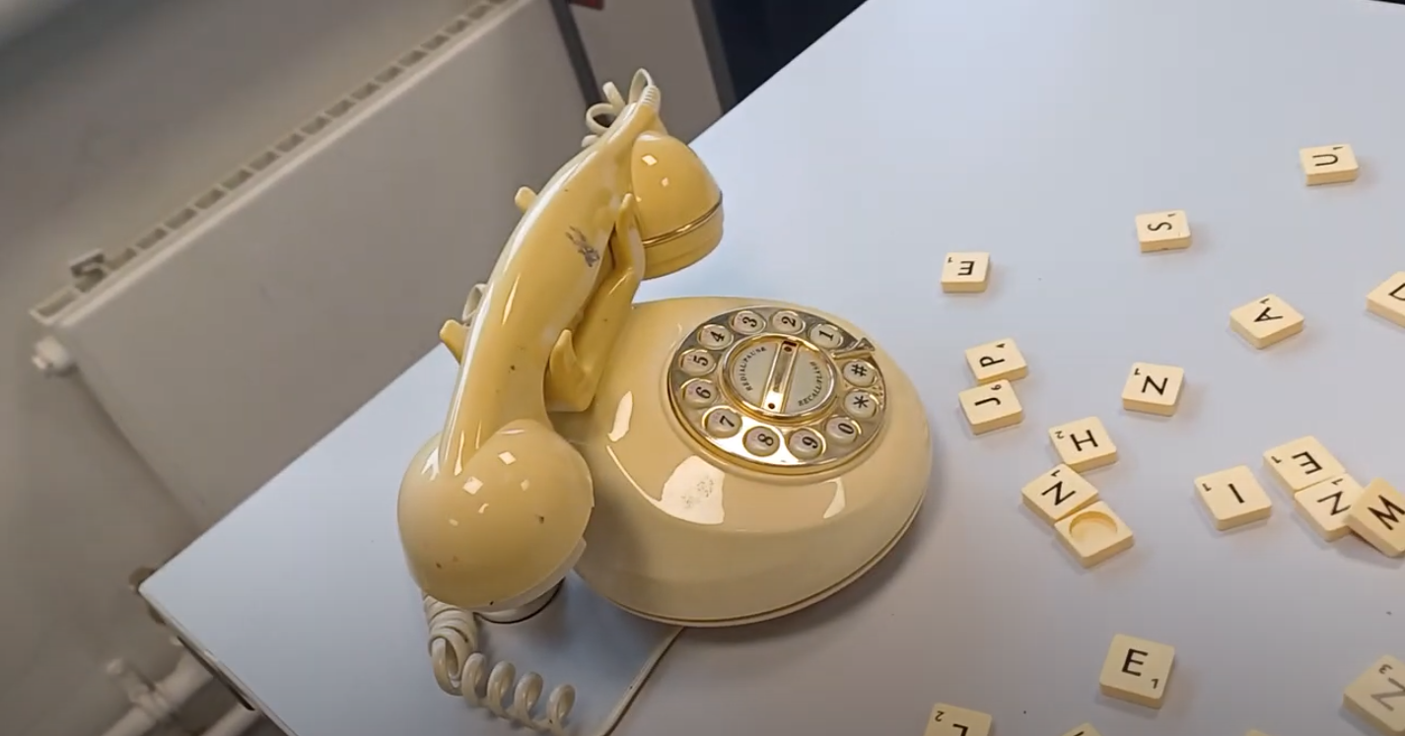
Name:
Candidate No:
Production Title:
Sheet X of 10
Scene Heading | Police Station INT - Mid Day
Shot No. | 15, 15B, 15C
Shot Type/ camera movement | Dolly + Dutch Angle
Lighting
Action/scene description/ dialogue from the screenplay | The DI looks at the phone as it rings
Diegetic Sound | Phone ringing (gets really loud for viewer to create tension).
Non Diegetic sound | Violins get louder and suddenly cut off
Duration of shot | 6 seconds | Transition Type | Instant fade to black. (Cut to black)

